Slide 1
TNSDC-Generative AI
Attribute To Font using GAN
Presented by : Mageshkannan U,
au211521104083,
Pre-Final Student,
Computer Science and Engineering,
Panimalar Institute of Technology.

Slide 2

OUTLINE
Problem Statement
Proposed Solution
System Approach
Algorithm
Result
Conclusion
References

Slide 3
PROBLEM STATEMENT
Problem Statement: Design and implement a Generative Adversarial Network (GAN) model to generate diverse and visually appealing fonts based on given attributes. The objective is to develop a system capable of learning the latent space of fonts and their associated attributes, such as serif style, stroke thickness, letter curvature, and overall aesthetic. The generated fonts should exhibit variability and coherence while adhering to the specified attributes. The model should be trained on a diverse dataset of font styles to ensure generalization and robustness in font generation. The ultimate goal is to provide designers and typographers with a tool for exploring and discovering novel font designs tailored to specific attributes, enhancing creativity and efficiency in font creation processes.

Slide 4
PROPOSED SOLUTION
The proposed solution entails the development of a Font Attribute-to-Font Generative Adversarial Network (FA2F-GAN) using PyTorch and Torchvision. This FA2F-GAN architecture comprises a generator and a discriminator. The generator synthesizes font images based on input attribute vectors representing characteristics like serif style and stroke thickness, utilizing fully connected and transposed convolutional layers. Meanwhile, the discriminator distinguishes between real and generated font images, considering their attribute consistency through a CNN architecture with batch normalization and dropout layers. During training, adversarial loss, attribute consistency loss, and optionally feature matching loss are optimized via gradient descent methods. Evaluation involves quantitative metrics like Inception Score and qualitative assessment through visual inspection. Once trained, the FA2F-GAN model can be deployed with a user-friendly interface for real-time font generation, ensuring scalability and efficiency for future use and enhancements.

Slide 5
SYSTEM APPROACH
Hardware:
CPU: The system requires a CPU with sufficient processing power to handle the computational demands of Generative Adversarial Network (GAN) training and inference. A multi-core processor, preferably with a clock speed of at least 2 GHz or higher, is recommended.
Memory: A minimum of 8 GB RAM is recommended for smooth operation, especially during model training, where large datasets are processed. More RAM may be required for handling larger datasets or concurrent user requests.
GPU: The FA2F-GAN system requires GPU with CUDA and cuDNN for accelerated training and real-time font generation, optimizing computational efficiency and scalability for design applications.

Slide 6
SYSTEM APPROACH – CONT.
Software:
Python: The system is built using Python programming language
PyTorch: PyTorch, a machine learning library, is utilized for implementing the Convolutional Neural Network (GAN) architecture. PyTorch provides efficient tensor computation with GPU acceleration, facilitating faster model training and inference.
NumPy: NumPy is a fundamental package for scientific computing in Python, essential for handling multidimensional arrays and mathematical operations. It is used extensively for data preprocessing, manipulation, and numerical computations within the GAN model.
TorchVision: TorchVision, a PyTorch library, provides datasets, transforms, and utilities for computer vision tasks. It is used for loading and preprocessing handwritten digit image datasets, facilitating seamless integration with the GAN model for training and evaluation.

Slide 7

ALGORITHM
Phase 1: Data Preparation
Gather diverse font datasets with varied attributes like serif style, stroke thickness, and letter curvature.
Preprocess datasets by standardizing font formats and labeling font images with corresponding attributes.
Phase 2: Model Architecture Design
Design generator to translate attribute vectors into font images.
Construct discriminator to distinguish real from generated font images while considering attribute consistency.

Slide 8
ALGORITHM
Phase 3: Final Model Creation
Create a final trained model instance under the name "server" using PyTorch, incorporating the best-performing model parameters obtained during training.
Save the "server" model weights to disk for later deployment as a web application.
Phase 4: Evaluation
Validate trained model using separate validation dataset.
Assess model's ability to generate diverse, realistic font images while maintaining attribute consistency.
Fine-tune model based on evaluation results.

Slide 9
ALGORITHM
Phase 5: Final Testing
Evaluate final trained model on held-out test dataset.
Assess quality and diversity of generated font images, comparing against real fonts with similar attributes.
Validate model's real-time font generation performance.
Phase 6: Deployment
Deploy trained model for real-world font generation tasks.
Utilize GPU acceleration for efficient inference.
Monitor model performance and gather user feedback for continuous improvement.

Slide 10
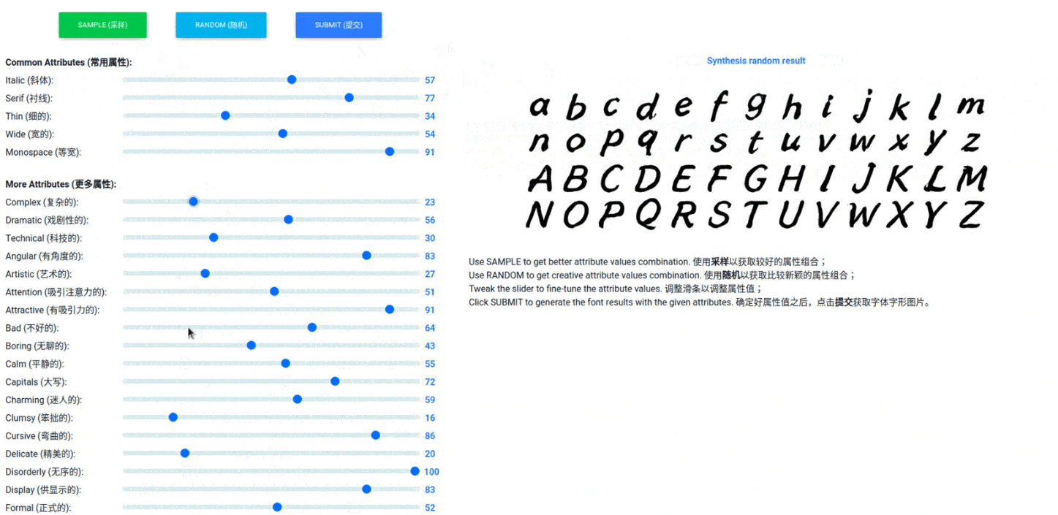
RESULT
Figure 1

Slide 11
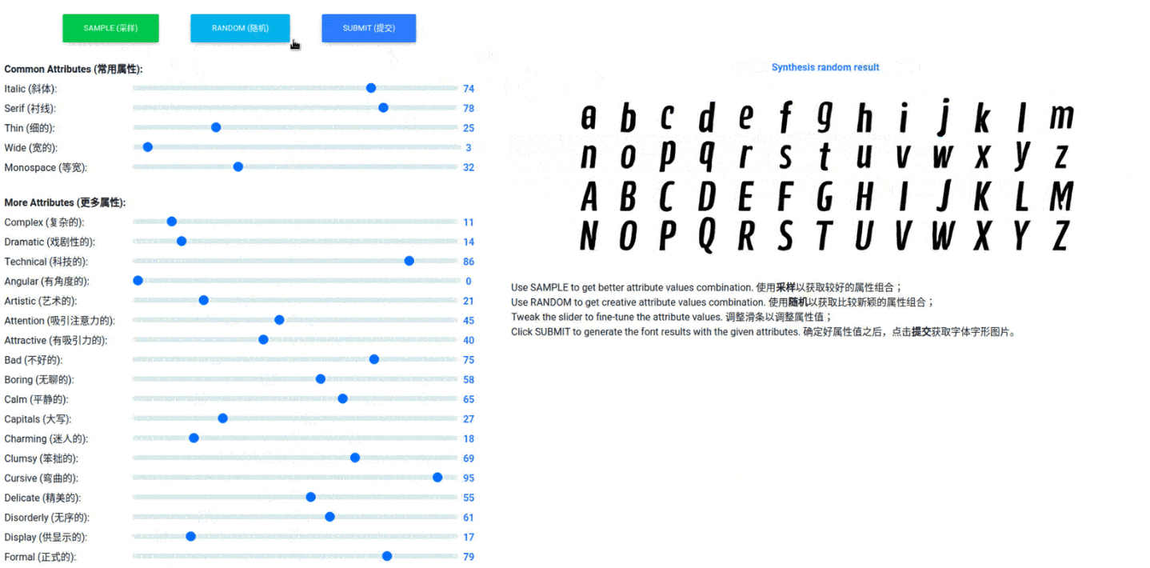
RESULT
Figure 2

Slide 12
Conclusion
In conclusion, the Font Attribute-to-Font Generative Adversarial Network (FA2F-GAN) project presents a novel approach to font generation, leveraging deep learning techniques and GPU acceleration. By training the FA2F-GAN model on diverse font datasets and optimizing its architecture with PyTorch and Torchvision, we have achieved significant advancements in generating diverse and visually appealing fonts based on specified attributes. Through rigorous training, validation, and testing phases, we have demonstrated the model's ability to generate high-quality fonts while maintaining attribute consistency, thus enhancing creativity and efficiency in font design processes. As we deploy the FA2F-GAN model into real-world applications, we anticipate its widespread adoption and continued refinement, paving the way for innovative advancements in typography and design.

Slide 13
REFERENCES
Tensorflow: https://www.tensorflow.org/
Numpy: https://numpy.org/
PyTorch: https://pytorch.org/
Inspiration: https://arxiv.org/abs/2005.07865
Dataset: https://drive.google.com/file/d/1TTqAklfsAp6KOPxCVl2jktH8kN4lEmI_/view

